Slide 1

Analysis of the most problematic non-emergency types of requests and building a prediction model using data from the 311 New York service.
for any questions, write to the mail: a.dziubkou@gmail.com

Slide 2
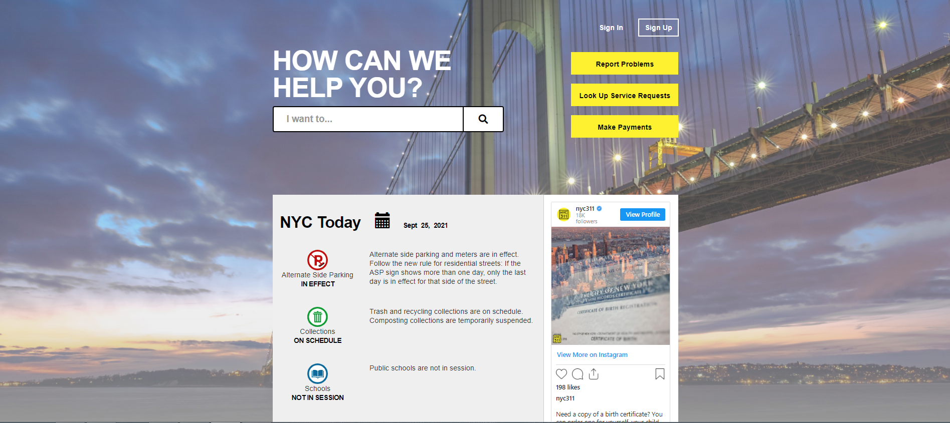
What is the 311 service, the Department of Housing Preservation and Development of New York City
311 is the online service that provides the public with quick, easy access to all New York City government non-emergency services and information while offering the best customer service. Also, 311 service do an analysis of service delivery. We can consider it as a link between usual people and government non-emergency services. The Department of Housing Preservation and Development of New York City are one of these services that is available under 311 and help to solve issues with housing and buildings.
2

Slide 3
4 Steps to analyze requests of 311 services:
Step
1
Analyze the current numbers of complaints:
Step
1.1
4
TO DO STEPS
identify top priority types of complaints on which Department of Housing Preservation and Development of New York City should concentrate first.
Step
1.2
identify the most problematic area(districts) with the highest amount of the top priority complaints(same for streets, zip). Show it in on a map.
Step
1.3
determine whether there is a relationship between the top problematic district with the with the most common complaint and the land plot, geographical data of the land object, tax characteristics
Based on data from : Analytics of the Department of Housing Preservation and Development of New York City Services Requests
2
Need to build a prediction model based on land plot, geographic data of the land object, tax characteristics that can help identify most significant potential problems before it appears
Step
3

Slide 4

Data source – Cloud databases:
Access to cloud databases is through the SODA API.
What is SODA APISODA API = The Socrata Open Data API (SODA) provides programmatic access to this dataset including the ability to filter, query, and aggregate data. More info(https://dev.socrata.com/docs/queries/)
Database 1: "311 Service Requests from 2010 to Present" - link (https://data.cityofnewyork.us/Social-Services/311-Service-Requests-from-2010-to-Present/erm2-nwe9)
Database 2: "Primary Land Use Tax Lot Output (PLUTO)" - link(https://data.cityofnewyork.us/City-Government/Primary-Land-Use-Tax-Lot-Output-PLUTO-/64uk-42ks)
4

Slide 5
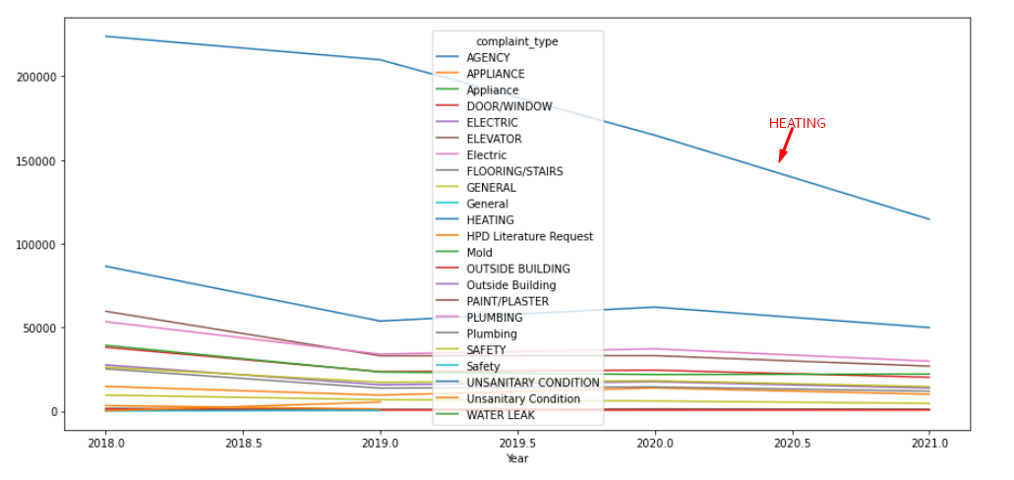
Complaints in dynamic since 2018 overview:
5

Slide 6
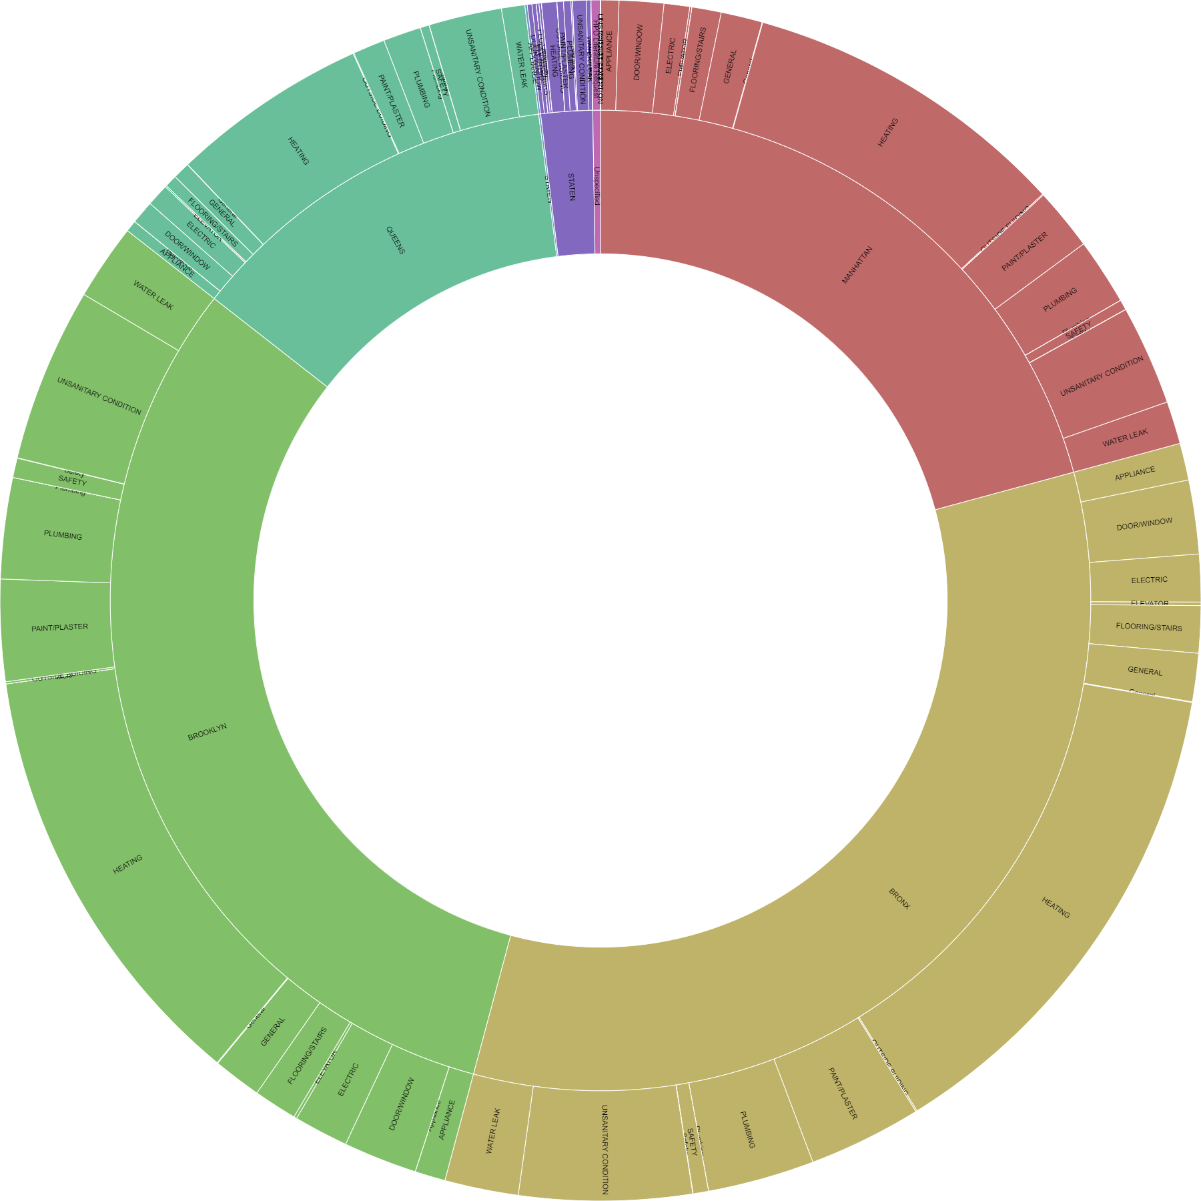
Distribution of complaints by districts:
Most problematic district: Bronx
The most common complaint: Heating
This is a Pivot table per complaint type/borough/num of complaints in a circle dendrogram format:
6

Slide 7
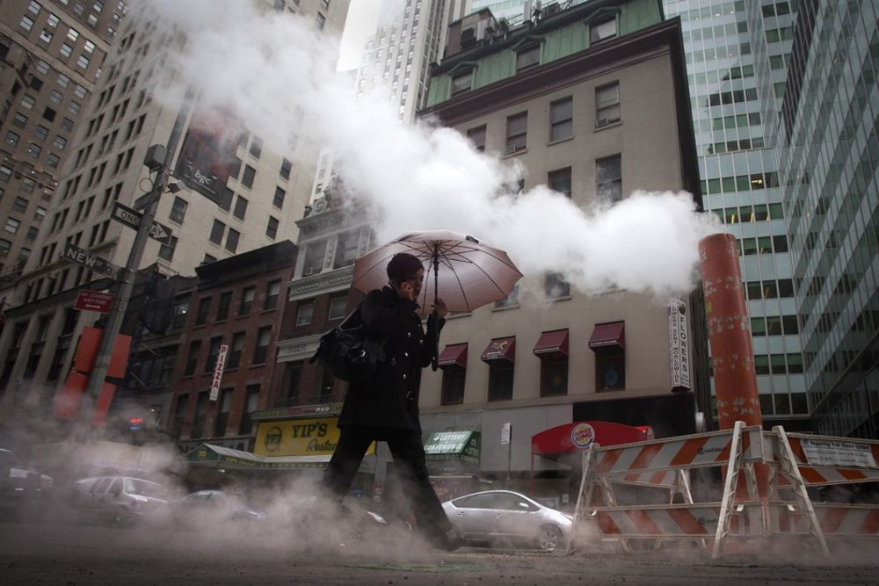
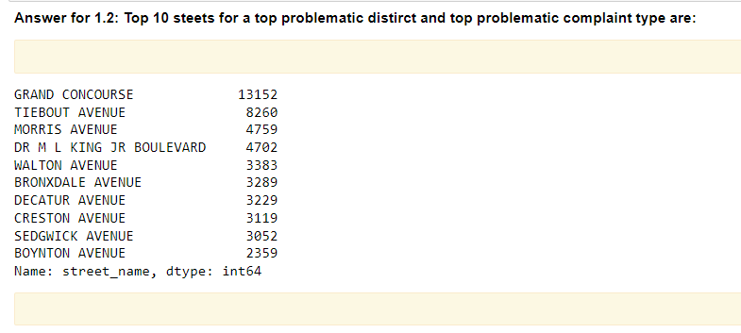
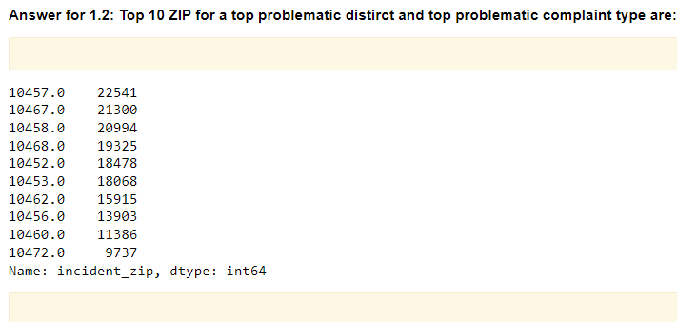
7

Slide 8
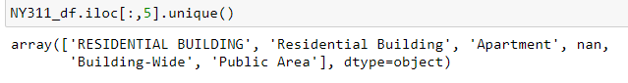
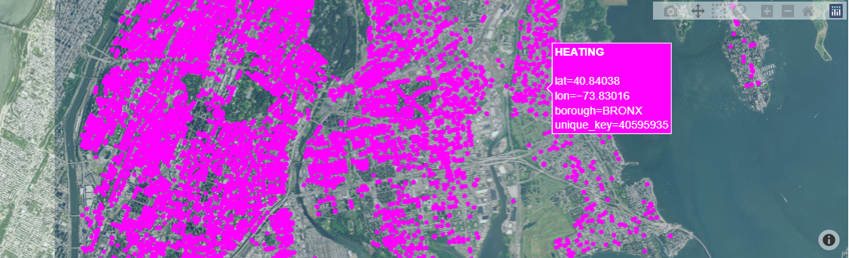
Now we can display complaints from any location_type graphically using any filters we like (on this map we have only borough as a filter with complaints on a hitting since 2018):
Locations types that we have:
8

Slide 9
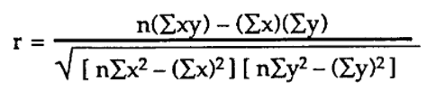
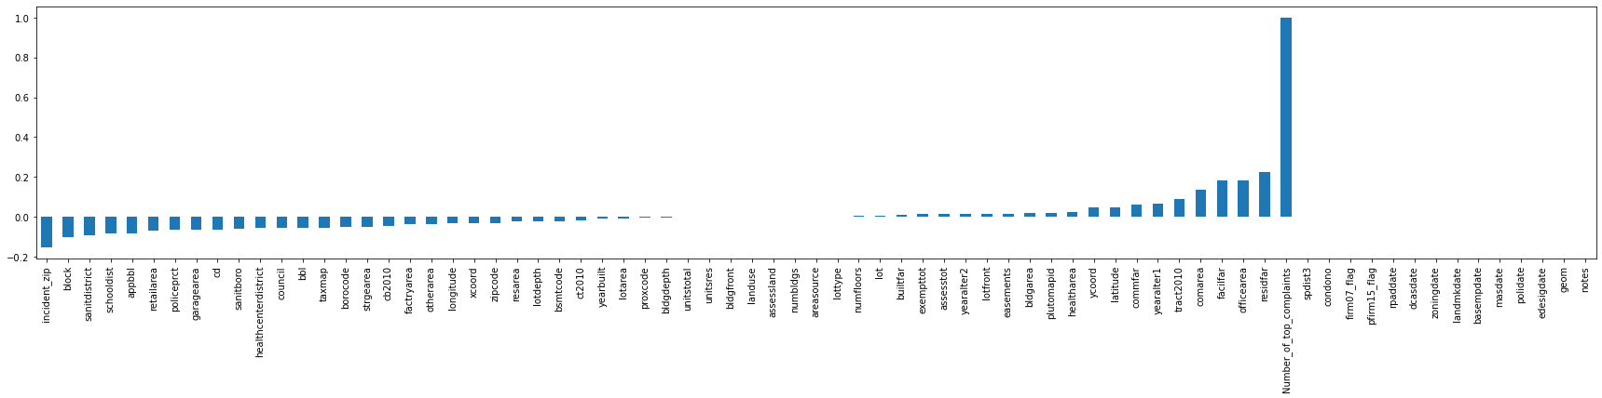
What characteristics of a house affect the number of complaints about heating in the Bronx:
What characteristics of a house affect the number of complaints about heating in the Bronx:
Pearson correlation coefficient:
9

Slide 10



What we can suggest:
We can divide the "number of complaints" into a binary category: 0 - the acceptable number of complaints in the Bronx about heating,
1 - the critical number of complaints in the Bronx about heating
And suggest to deal with it first
Let's take the 40 place from the top according to the number of complaints and use it as a trigger for a "really problematic location".
Place 40 equals to 952 complaints
10

Slide 11


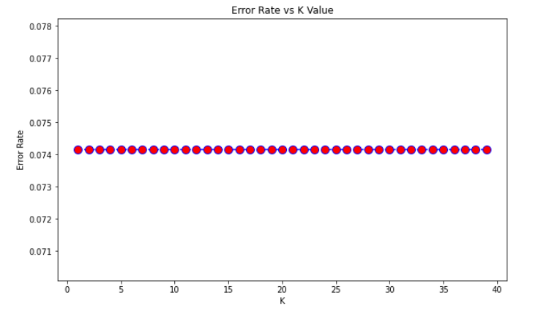

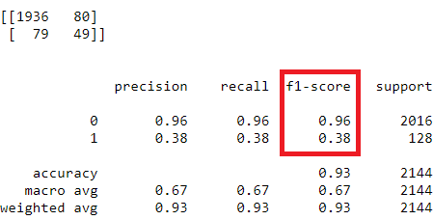
KNN algorithm
Changing the hyperparameters didn't help much:
11

Slide 12


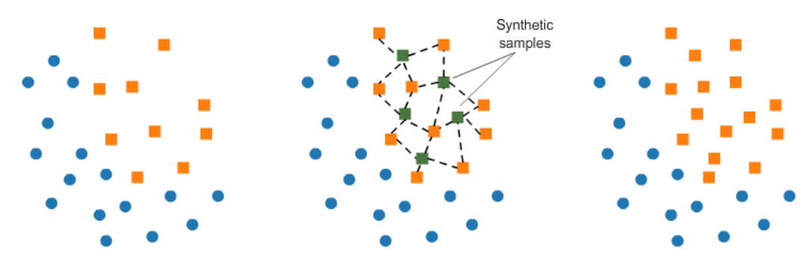
Imbalanced Classes
Let’s try to use SMOTE over-sampling
12

Slide 13
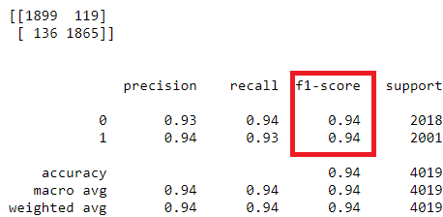
KNN algorithm second try
Changing the hyperparameters didn't help much again and this is logical:
13

Slide 14
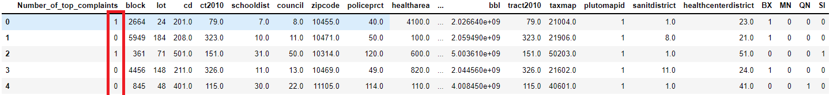
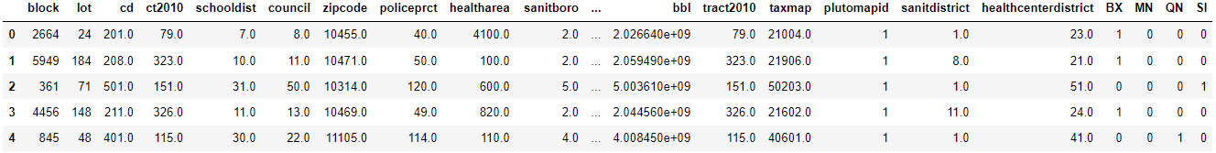
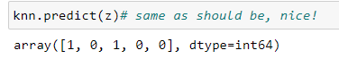
Manual test:
Let’s take 5 random strings from the database:
Drop results:
Predict:
14

Slide 15

Overview of the work done:
In the course of the task , the following points were achieved:
We were able to analyze about 10 million lines of complaints about various non-emergency complaints since 2018 in New York. Most valuable of them we visualized.
We have decided which of complaints are the most frequent - these are undoubtedly problems with heating. So it's recommended to take some kind of improvement for this type of complaint first.
Analyzing statistical data on complaints about heating, we determined the most problematic boroughs, postal codes and streets.
We have determined the dependence of the parameters of houses, characteristics of tax plots, geographical location on the number of complaints about heating
We have built a binary predictive model that determines with 94% accuracy whether a particular "location type" will be problematic based on the parameters of the land plot, geographical data of the land object, tax characteristics
Confirmed the accuracy by manual verification
This work can be easily scaled for new data
15

Slide 16
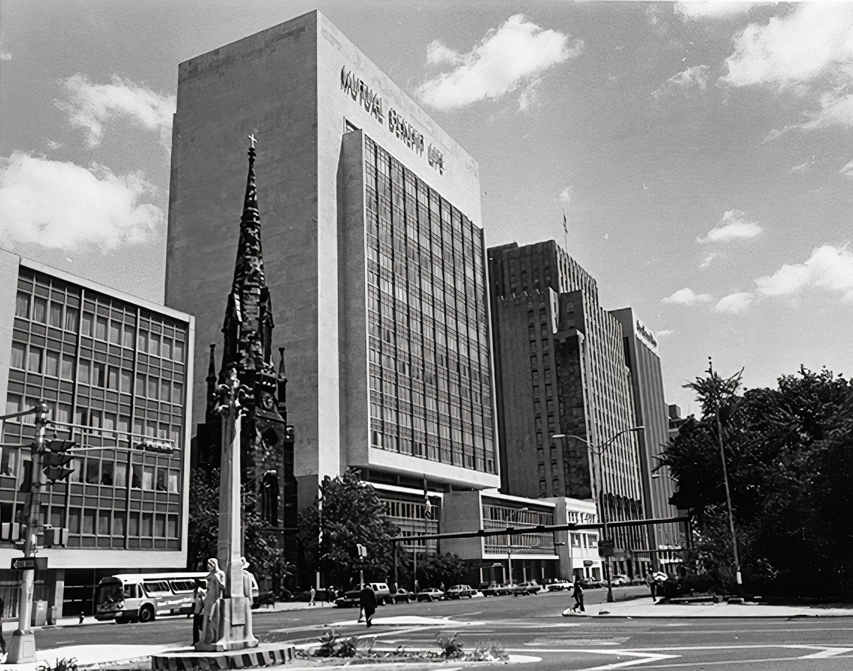
Thank you for your time. Be safe!
for any questions, write to the mail: a.dziubkou@gmail.com
16

